Slide 1
Developing Apps for Touch and Mobile Devices

Slide 2
Objectives
In this session, you will learn to:
  Develop universal apps
  Update your existing apps to universal Windows apps

Slide 3


JavaScript Project Templates

Slide 4
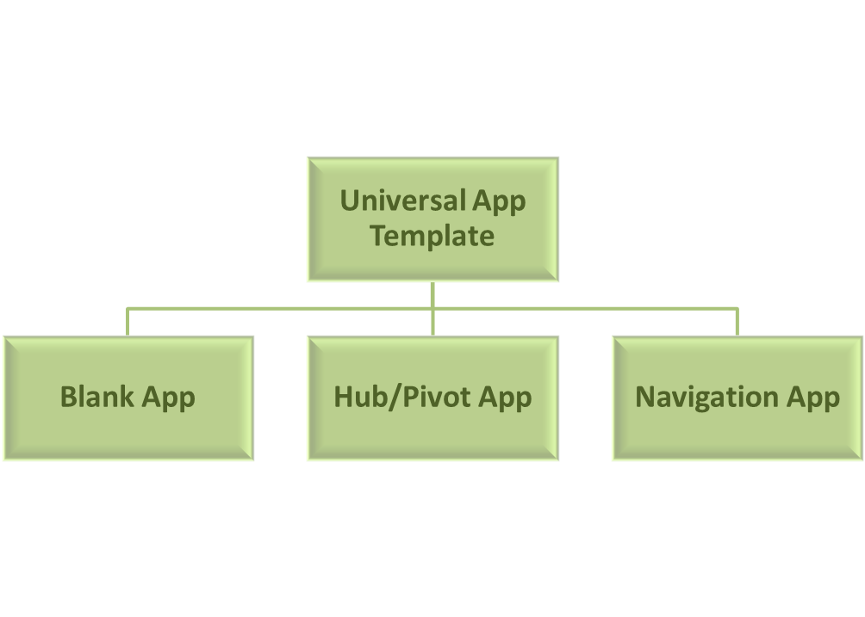
JavaScript Project Templates (Contd.)
In Microsoft Visual Studio, you can use the Universal Apps JavaScript project template for developing universal apps.
The Universal App template contains the following three project templates:

Slide 5
JavaScript Project Templates (Contd.)
Blank App
  Blank apps are empty apps with minimum functionality.
  When you create a universal app using the Blank App template, an empty app is created with a single page.
  The app contains a content placeholder where you can place UI elements.
  You can add pages, controls, and content to the project.
  Blank apps do not have any predefined layout or user interface.
  They include following files:
  default.html
  default.css
  default.js
  package.appxmanifest
  Various image files

Slide 6
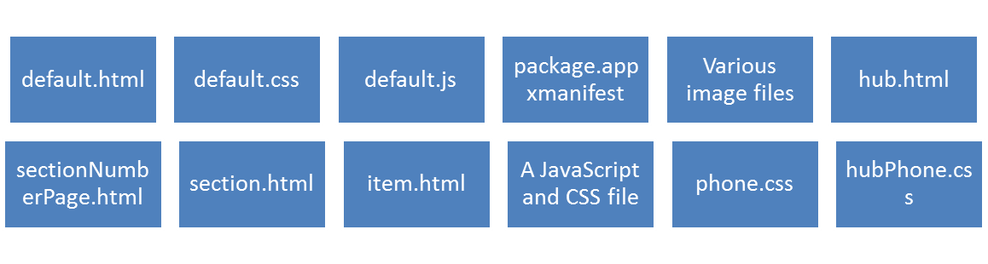
JavaScript Project Templates (Contd.)
Hub/Pivot App
  Hub/pivot apps display various sections in a horizontal layout.
  When you create a universal app using the Hub/Pivot App template, a shared solution for the Windows Phone Store app and the Windows Store app is created.
  In this template, each section represents a category of content, such as new items, highlighted items, and categories of items.
Hub/Pivot apps include following files:

Slide 7
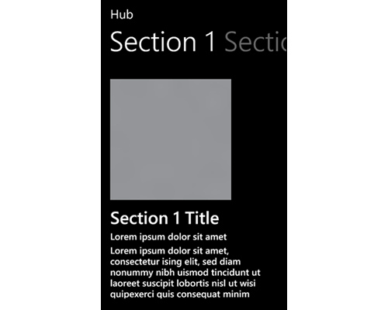
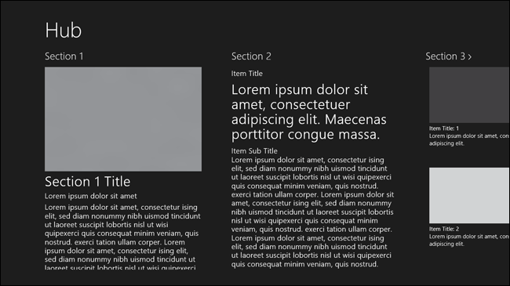
JavaScript Project Templates (Contd.)
  The following figures show the layout of the Hub/Pivot project.
Hub/Pivot Project Template for a Windows App
Hub/Pivot Project Template
for Windows Phone App

Slide 8
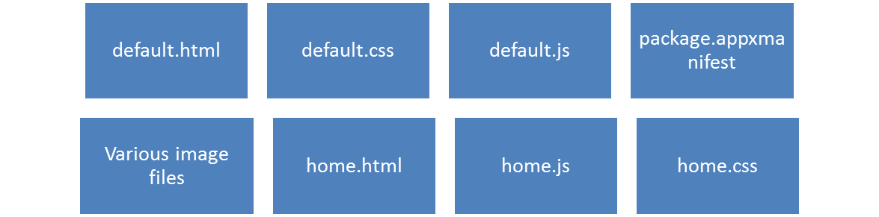
JavaScript Project Templates (Contd.)
Navigation App
  The Navigation App template provides a basic navigation functionality by implementing the navigation model for Windows Runtime apps.
  This template has only one minimal page fragment to which more page fragments can be added by using the Page Control item template.
  A Navigation App template includes the following files:

Slide 9
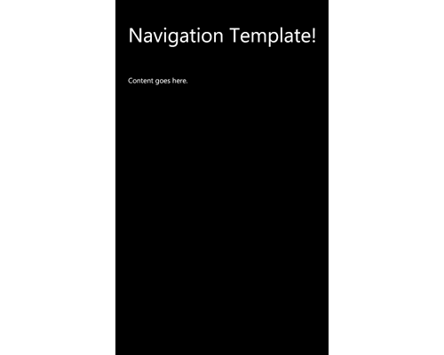
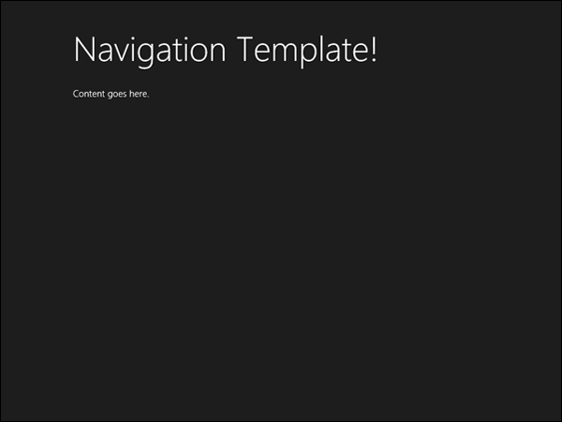
JavaScript Project Templates (Contd.)
  The following figures show the layout of the Navigation project.
Navigation Project
Template
for Windows Phone App
Navigation Project Template
for Windows App

Slide 10
Task 7.1: Creating a Universal App Project

Slide 11
Using IntelliSense for a Specific Platform
While creating a universal app, a major part of the code can be shared between a Windows project and a Windows Phone project.
There may be a part of the code that may target a specific platform only.
For writing code for a specific platform, you may need to get IntelliSense for the specific platform.
IntelliSense is specific to the context of code editor
IntelliSense displayed at anytime is specific to Windows or Windows Phone

Slide 12

Using IntelliSense for a Specific Platform (Contd.)
Context Switcher drop-down list
  In Microsoft Visual Studio, if you open a JavaScript file available in the shared folder of an application, you can see Context Switcher drop-down list.
  The Context Switcher drop-down list lets you select IntelliSense for the desired platform.
Context Switcher Drop-down List
When you select a platform from this drop-down list, the IntelliSense window shows the options for the selected platform.

Slide 13
Task 7.2: Changing the Target Platform

Slide 14
Handling Behavior Differences Between Platforms
  Universal apps run on a variety of Windows devices.
  The devices may differ in:
  Size
  Resolution
  Basic functionalities
  While writing code for a shared platform, you need to consider the behavioral differences between the Windows and Windows Phone platforms such as UI elements and controls.
Windows Phone devices contain an in-built back button whereas the Windows do not. Users can navigate back with the help of the in-built back button of the device.

Slide 15
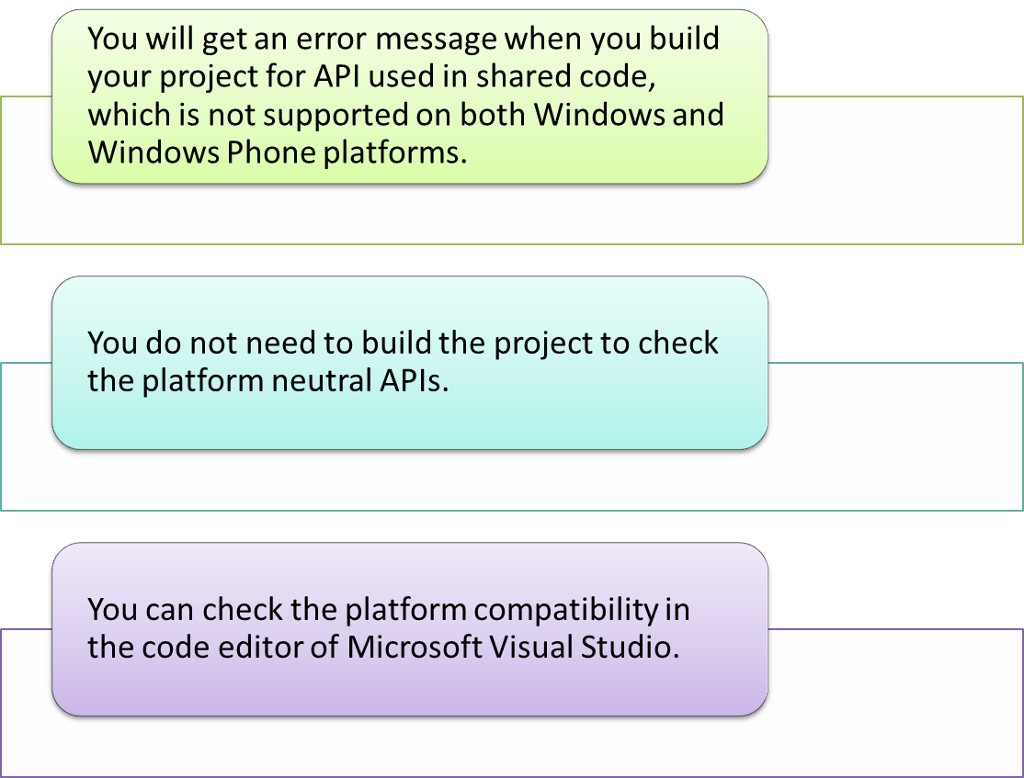
Handling Behavior Differences Between Platforms (Contd.)

Slide 16
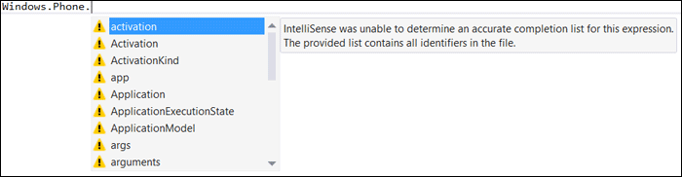
Handling Behavior Differences Between Platforms (Contd.)
When you use platform-dependent code in the shared project, you will witness warning icons in the IntelliSense.
Showing Warning Icons for Platform-specific API

Slide 17
Handling Behavior Differences Between Platforms (Contd.)
Tips to Handle Behavioral Differences between Windows and Windows Phone devices
  Identify the current platform:
  In the shared code, you may write the code that targets a specific platform.
  In such a situation, you need to first identify the platform by using the WinJS.Utilities.isPhone property.
  Use separate HTML files for platform-specific code:
  The screen-size difference results in the difference of layout on both the platforms.
  You need to design the app differently for each platform.
  For Windows app, the code is written in default.html file under the Windows project whereas for Windows Phone app, the code is written in the default.html file under the Windows Phone project.

Slide 18
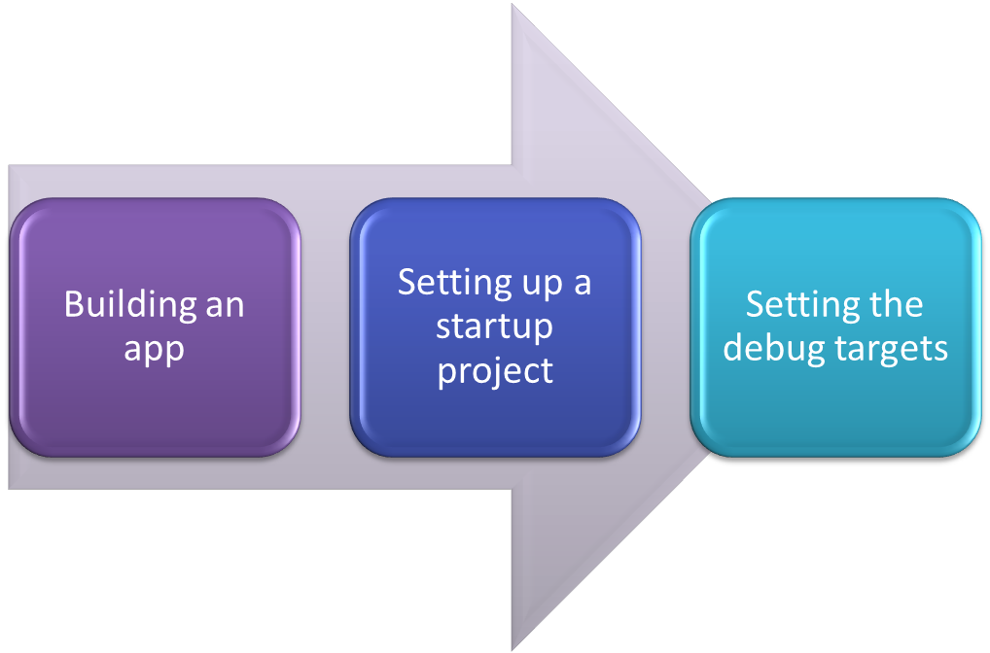
Building and Executing a Universal App
  After creating a universal app, you need to build and execute the project.

Slide 19
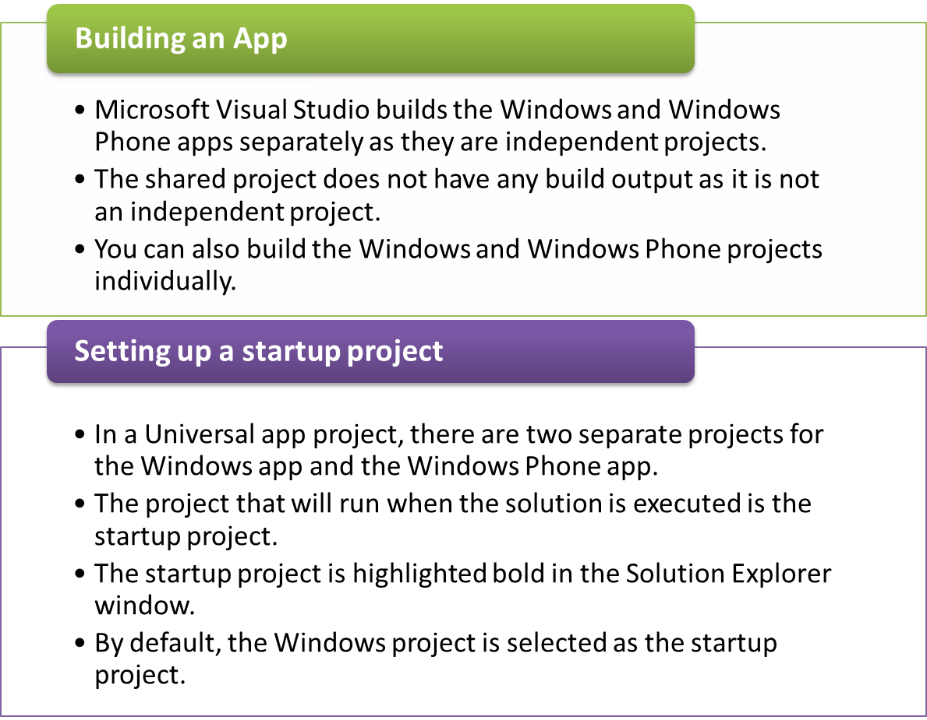
Building and Executing a Universal App (Contd.)

Slide 20
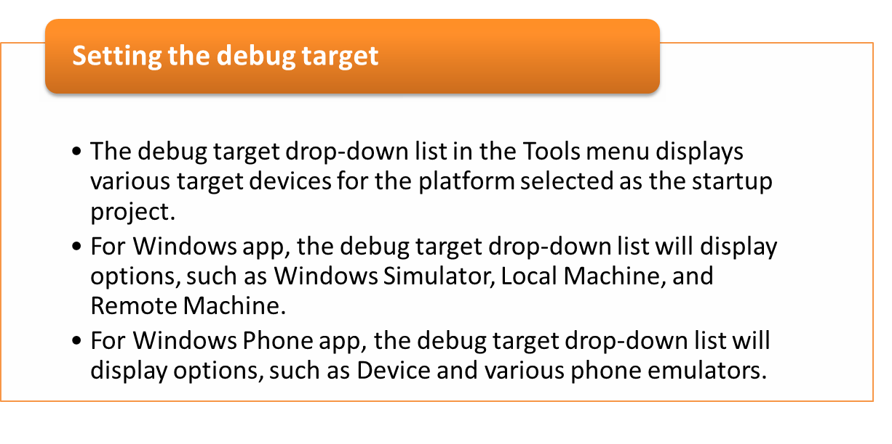
Building and Executing a Universal App (Contd.)

Slide 21
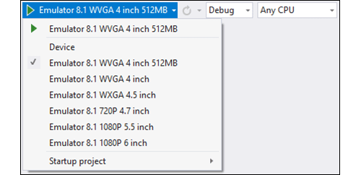
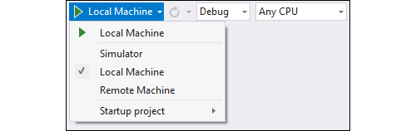
Building and Executing a Universal App (Contd.)
The Debug Target Drop-down List
for a Windows Phone App
The Debug Target
Drop-down List
for a Windows App

Slide 22
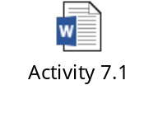
Activity 7.1: Creating a Universal App
Problem Statement:
Solution:
To complete this activity, you need to perform the following tasks:
  Create a navigation Universal Windows app.
  Add files in the app.
  Add UI elements to the Windows app.
  Add UI elements to the Windows Phone app.
  Add the common UI elements.
  Make the app functional.
  Execute the app and verify the output.

Slide 23
Updating a Windows 8.1 App to a Universal Windows App
  To update a Windows 8.1 app to a Universal Windows app, you need to add a Windows Phone 8.1 app project to it.
  The following projects are added to the existing solution:
  Windows Phone 8.1 project:
    The new Windows Phone 8.1 project has the same structure as the Windows project.
    This project contains HTML, JavaScript, and CSS files that target the Windows Phone platform.
  Shared project:
    This is an empty project added to the solution.
    You need to move the platform-neutral files to this project.
    Moving files to this project, enables you to share those files between the Windows and Windows Phone projects.

Slide 24

Task 7.3: Updating a Windows 8.1 App to a Universal Windows App

Slide 25
Updating a Windows Phone 8.1 App to a Universal Windows App
  To update a Windows Phone 8.1 app to a Universal Windows app, you need to add a Windows 8.1 app project to it.
  The following projects are added to the existing solution:
  Windows 8.1 project:
    The new Windows 8.1 project has the same structure as the Windows Phone project.
    This project contains HTML, JavaScript, and CSS files that target the Windows platform.
  Shared project:
    This is an empty project added to the solution.
    You need to move platform-neutral files to this project.

Slide 26

Just a Minute
Which one of the following tasks is performed while updating a Windows 8.1 app to a Universal Windows app?
Define UI elements for the Windows project separately in its HTML files.
Define UI elements for the Windows Phone project separately in its HTML files.
Move the JavaScript file in the Windows Phone project to the js folder in the Shared project.
Answer:
Define UI elements for the Windows Phone project separately in its HTML files.

Slide 27

Task 7.4: Updating a Windows Phone 8.1 App to a Universal Windows App

Slide 28
Activity 7.2: Converting an Existing Windows Phone 8.1 App to a Universal Windows App
Problem Statement:
Alice is a Windows Phone app developer. She has created a Windows Phone app that displays the welcome message to a user when a user enters the name in a text box and clicks the Submit button. Now, Alice wants to make this app a Universal Windows app. Help Alice to convert the existing Windows Phone 8.1 app into a Universal Windows app.
Solution:
To complete this activity, you need to perform the following steps:
  Add Windows app project.
  Move the common files to Shared project.
  Add UI elements to Windows app.
  Execute the app and verify the output.

Slide 29
Summary
In this session, I learned that:

